Slide 1
Team name –SSJA 1.Susanta Adak 2.Shantinath Samanta 3.Joydeb Jana 4.Arindam Panja

Slide 2
Project Report on “BANKING SYSTEM”
AIM of this project
The main aim of designing and developing this Internet banking System Java primarily based
Engineering project is to provide secure and efficient net banking facilities to the banking customers over the internet. Apache Server Pages, Oracle database used to develop this bank application where all banking customers can login through the secured web page by their account login id and password. Users will have all options and features in that application like get money from western union, money transfer to others, and send cash or money to inter banking as well as other banking customers by simply adding them as payees.

Slide 3
Main Goal
1. Motto- Our motto is to develop a software program for managing the entire bank process related to Administration accounts customer accounts and to keep each every track about their property and their various transaction processes efficiently.
Hereby, our main objective is the customer’s satisfaction considering today’s faster in the world.
2. Customer Satisfaction: Client can do his operations comfortably without any risk or losing of his privacy. Our software will perform and fulfill all the tasks that any customer would desire.

Slide 4
3. Saving Customer Time: Client doesn't need to go to the bank to do small operation.
4. Protecting the Customer: It helps the customer to be satisfied and comfortable in his choices, this protection contains customer’s account, money and his privacy.
5. Transferring Money: Help client transferring money to/or another bank or country.

Slide 5
Administrative Modules
Here in my project there are two types of modules. This module is the main module which performs all the main operations in the system. The major operations in the system are:
Admin Module
Admin can access this project there is an authorization process. If you login as an Admin then you will be redirected to the Admin Home Page and if you are a simple user you will be redirected to your Account Home Page. This performs the following functions: Create
Individual Accounts, Manage existing accounts, View all transactions, Balance enquiry,
Delete/close account etc.

Slide 6
1- Admin login
2- Add/delete/update account
3- Withdrawal/deposit/statements transaction
4- Account Information
5- User details list
6- Active/Inactive account
7- View transaction histories

Slide 7
User Module
A simple user can access their account and can deposit/withdraw money from their account.
User can also transfer money from their account to any other bank account. User can see their transaction report and balance enquiry too.
1- User login, use PIN system
2- Creating/open new account registration
3- Funds transfer (local/international/domestic)
4- View statements transaction
5- User account details
6- Change Password and Pin
7-auto OTP generate email

Slide 8
Software Requirements
Windows/Macos/Linux
Technology Used
Java, Hibernate
Hardware Requirements
Hard Disk – 2 GB.
RAM required – 512 MB (minimum)
Database Used
Oracle 21c

Slide 9
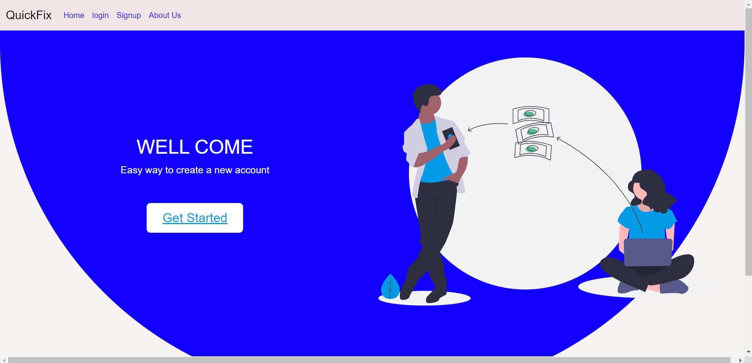

Slide 10
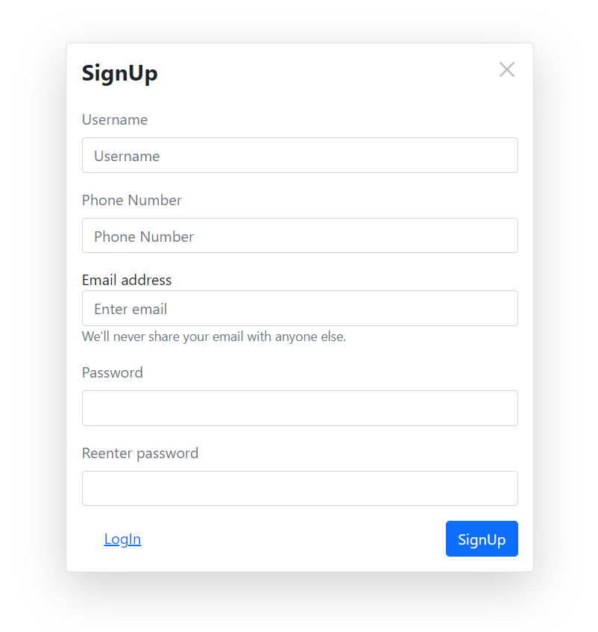

Slide 11
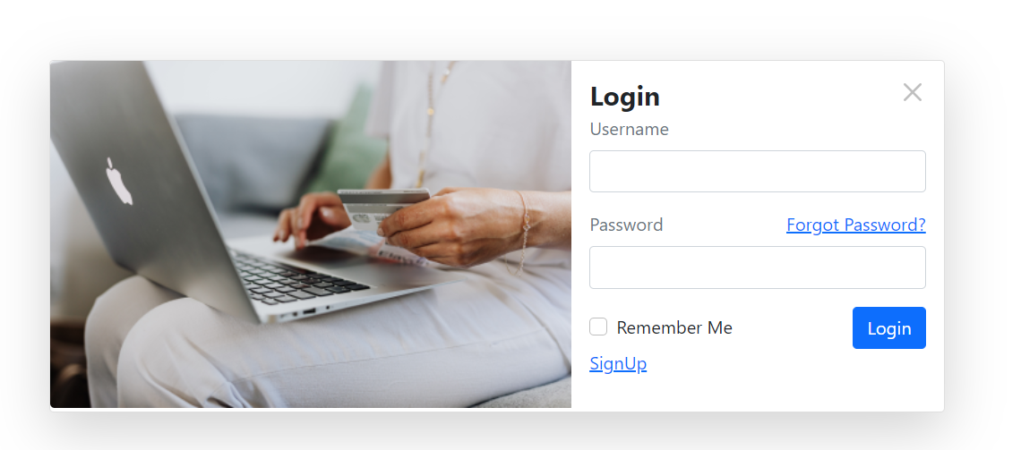

Slide 12
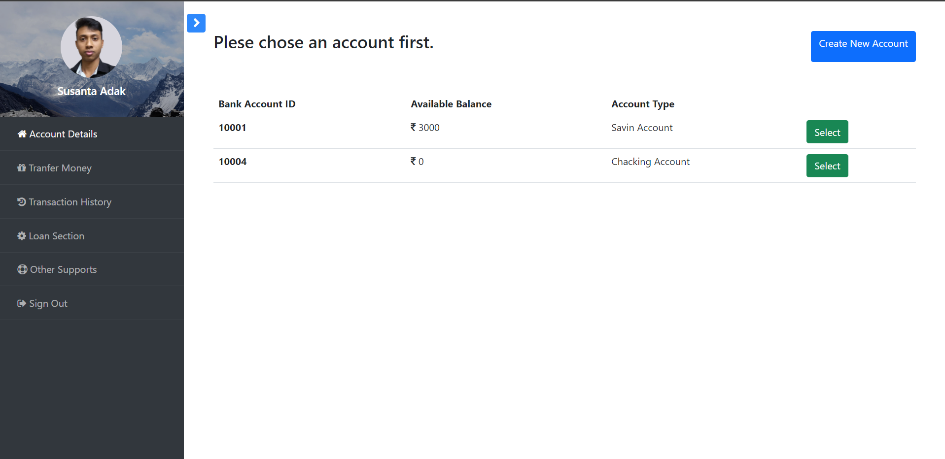

Slide 13
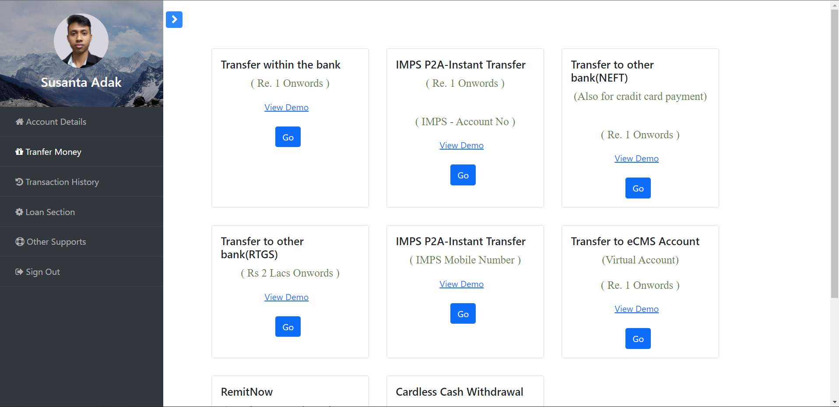

Slide 14
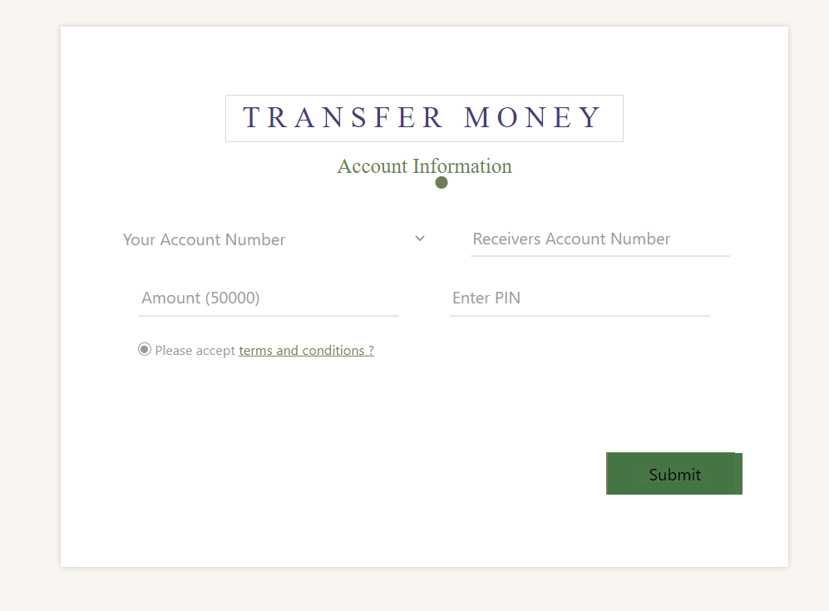

Slide 15
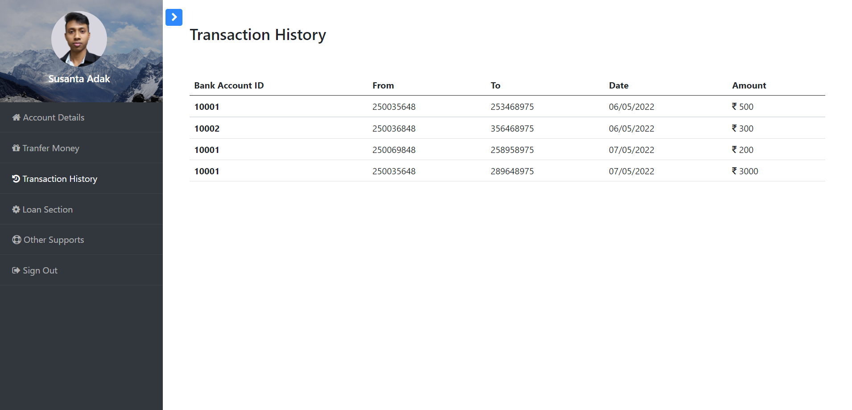

Slide 16
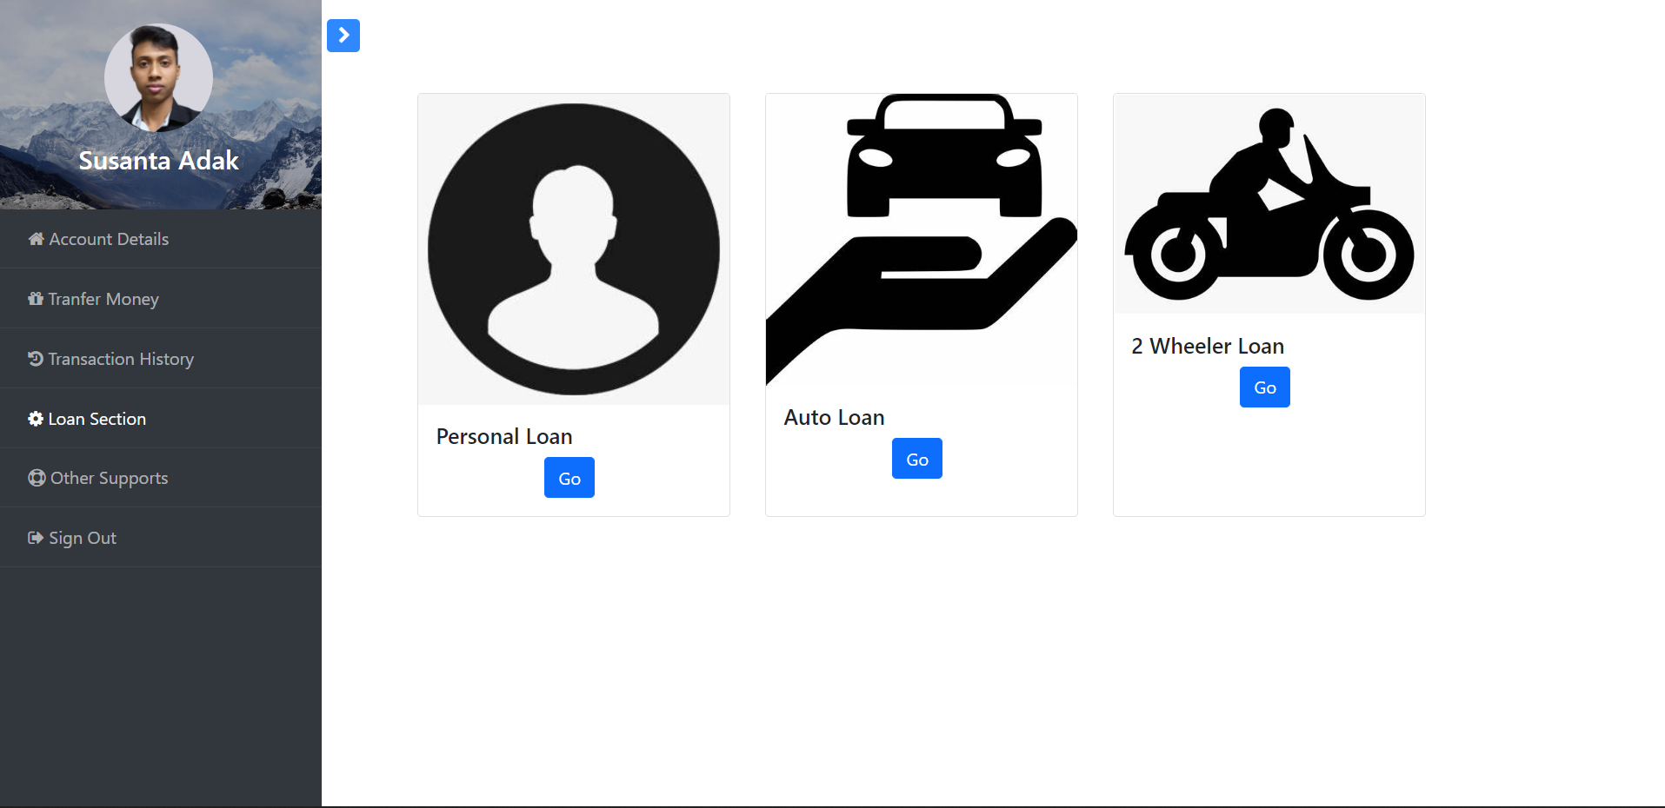

Slide 17
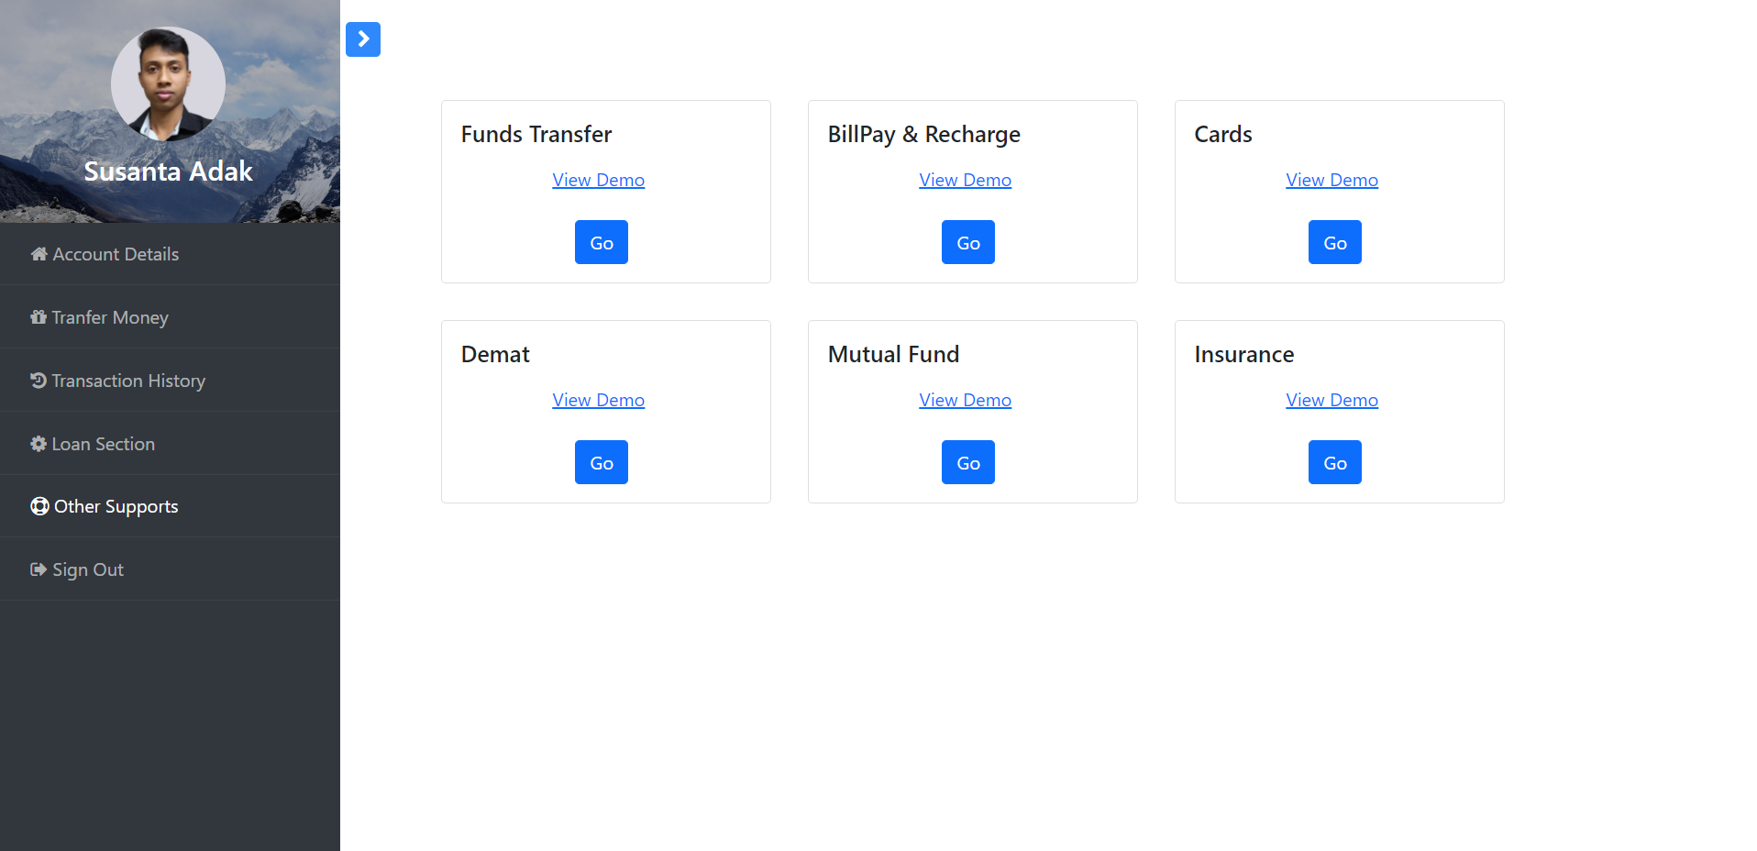

Slide 18
What we fix
1. Automation banking system
2.Reduce important time for any person
3.Reduce duplicate use with oracle 21c database
4.Our one of the best goal that all person use the online banking system
5.Complete KYC from home

